Slide 1

Error Analysis
Carrying out error
analysis
deeplearning.ai

Slide 2
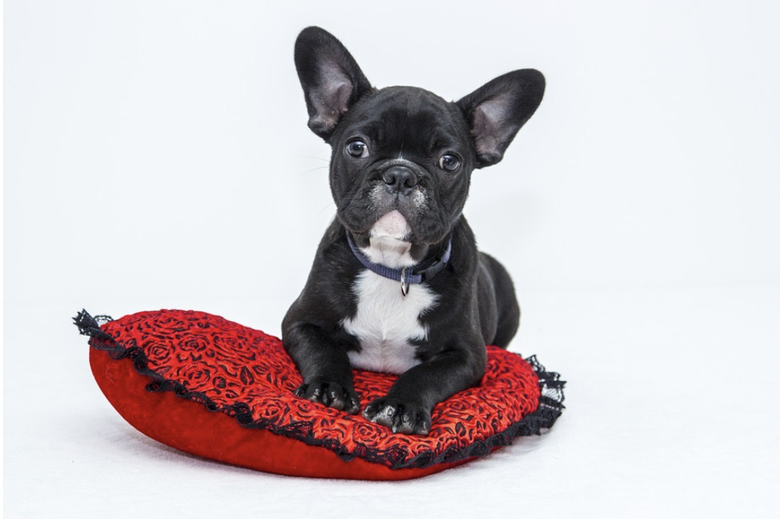
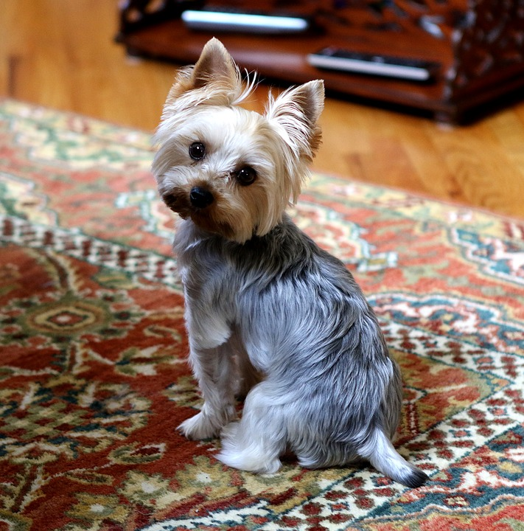
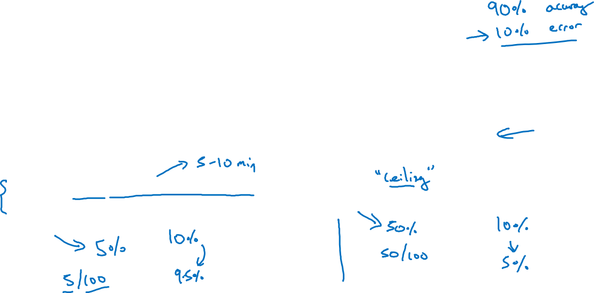
Look at dev examples to evaluate ideas
Should you try to make your cat classifier do better on dogs?
Error analysis:
Get ~100 mislabeled dev set examples.
Count up how many are dogs.

Slide 3
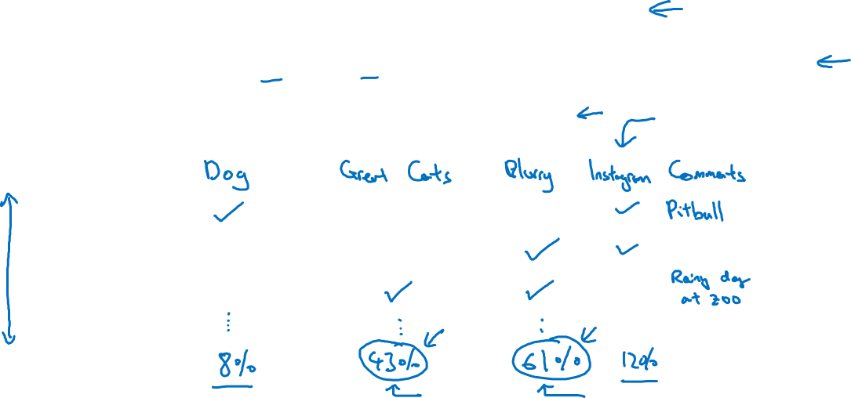
Evaluate multiple ideas in parallel
Ideas for cat detection:
Fix pictures of dogs being recognized as cats
Fix great cats (lions, panthers, etc..) being misrecognized
Improve performance on blurry images
Image
1
2
3
% of total
.
.
.

